Slide 1

Reddit Clone Application
& Service Development using Spring boot v5 and Angular 2022
Speaker: Genadi Nikolov,
Software engineering, faculty number: 62519

Slide 2
Content
Short Description
Use Cases
Main Component -> Spring
Main Component -> Angular
Photos

Slide 3
Description
Nowadays has changed the way we learn, discuss, and communicate with each other. The Discussion Clone Application(DCA) provides the ability for users to discuss topics, a vote section where you can download and vote for a post, and also a comment section where you can see the number of comments for each post. In addition, it allows the users to register or log in to their accounts to make posts or comments and administrators to control and manage their profiles. The system will be developed using Spring 5 Application Development Framework. It will be provided with a security system using Spring Security with JWT(JSON Web Token) Authentication for encoding information that will be securely transmitted as a JSON object. Also, the system will work with Spring Data JPA(Java Persistence API) based on MySQL to examine and control database applications. It will implement a web-based front-end client using Angular JavaScript/TypeScript libraries for asynchronous page data updates. It will have different links which will be posted by the users and the routing between pages will be done server-side using SpringMVC. The backend will be implemented as a REST API using JSON data serialization.

Slide 4
Use Cases
Browsing different posts and reading the comment section
Basic commands: registration, writing a comment, making a post, logging in, and logging out
More advanced actions: managing users, managing registration requests, managing topics, changing user data
Verification of the account and Security

Slide 5
Main components of Spring
Account :
  Verification
  Singing up
  Log in/ log out
Comment:
  Creating comment
  Getting comments -> single one and all comments
Post
  Creating -> posts or suposts
  Getting -> post, all posts, subpost, all subposts, by username, by subreddit
Reddit & Subreddit:
  Creating subreddit
  Getting -> single subreddit and all subreddits
  Refresh tokens
  Refresh tokens and JWT Provider;

Slide 6
Main components of Angular
Application
  Authentication
    Log in
    Signup
    User – profile
    Authentication guards
  Header
    Header components -> .css, .html, .ts files
  Home
    Home components -> .css, .hmtl, .ts files
  Post
    Create post -> components and payloads Post-model model and components
    View -> another part from post components
  Shared ->
    Comment
    Post-tile
    Side-bar
    Subreddit side-bar
    Vote button
    Post module and vote service components
  Subreddit
    Create subreddits
    List subreddits
    Subreddit model and service
  App routing modules, components and module

Slide 7
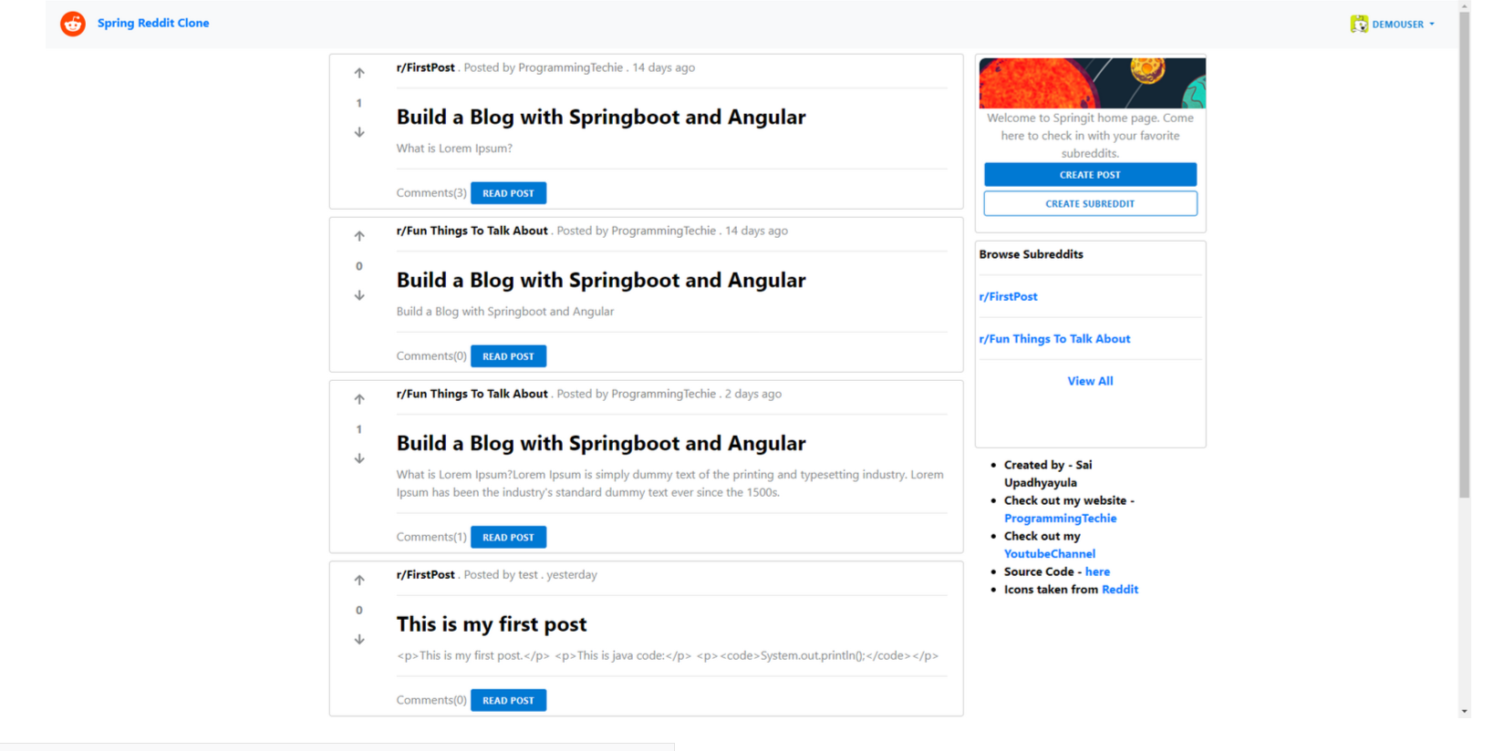
Photos
1. Home page/ View Post page/ User-Profile page

Slide 8
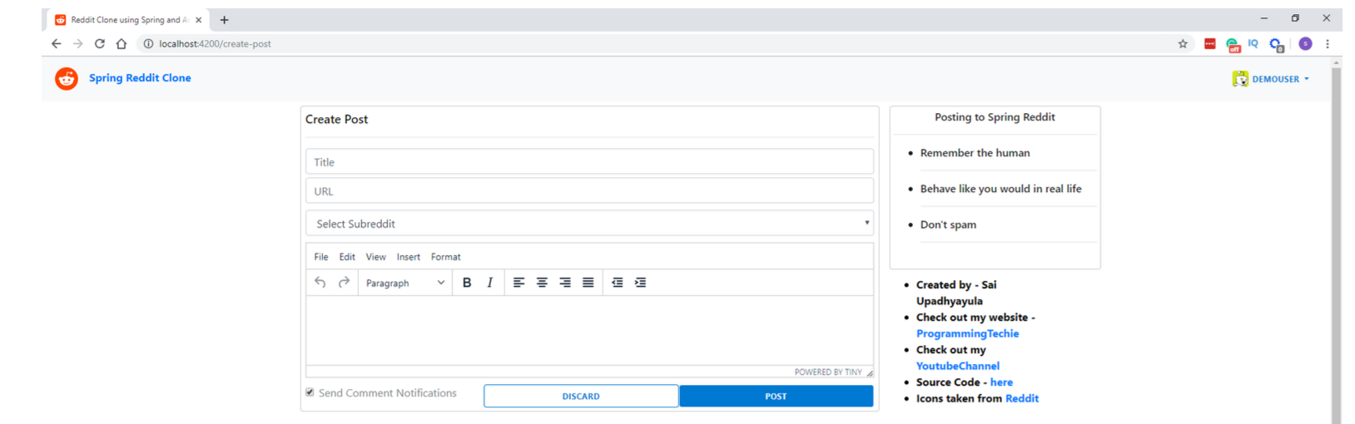
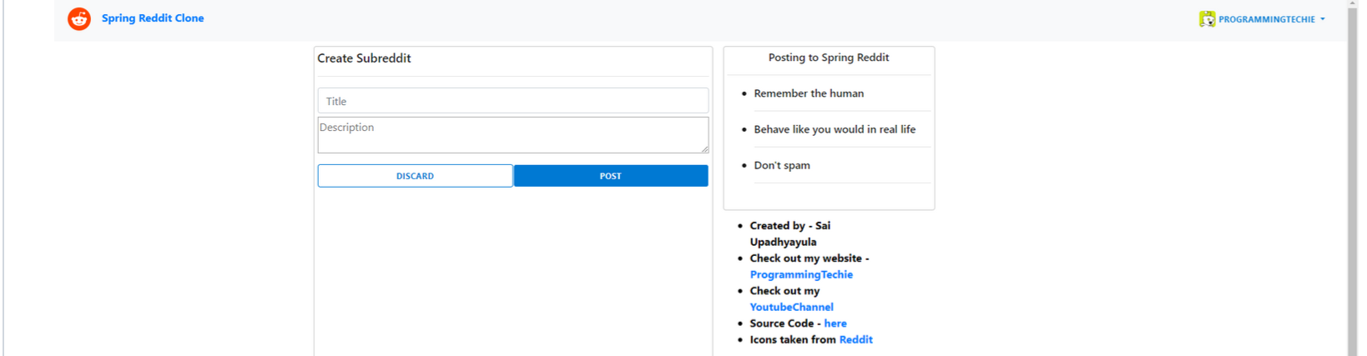
2.Create a Post/ Create Subreddit

Slide 9
Thank you for your attention!
Genadi Nikolov, faculty number: 62519

